Slide 1
Airline reservation system
Jahnavi Midathana
Jnana Prasanna Gunupuru
Hema Mallisetty
Shabnum Khatoon

Slide 2
Contents:
Abstract
Objective
UML diagrams
Classes
Advantages
Future scope
conclusion

Slide 3
Abstract
Airline reservation System is a computerized system used to store and retrieve information and conduct transactions related to air travel. The project is aimed at exposing the relevance and importance of Airline Reservation Systems. It is projected towards enhancing the relationship between customers and airline agencies through the use of ARSs, and thereby making it convenient for the customers to book the flights as when they require such that they can utilize this software to make reservations.

Slide 4
Objective:
The main objective of airline reservation system is to manage the details of airlines ticket, flights, customer, booking counter and venders . It manages all the information about airlines ticket, bookings ,venders, airline ticket . The project is totally built at administrative end and thus only the administrator is guaranteed the access . the purpose of the project is to build and application program to reduce the manual work for managing the airline tickets, flights, bookings , customer . Its tracks all the details about the customer, booking counter, venders.

Slide 5
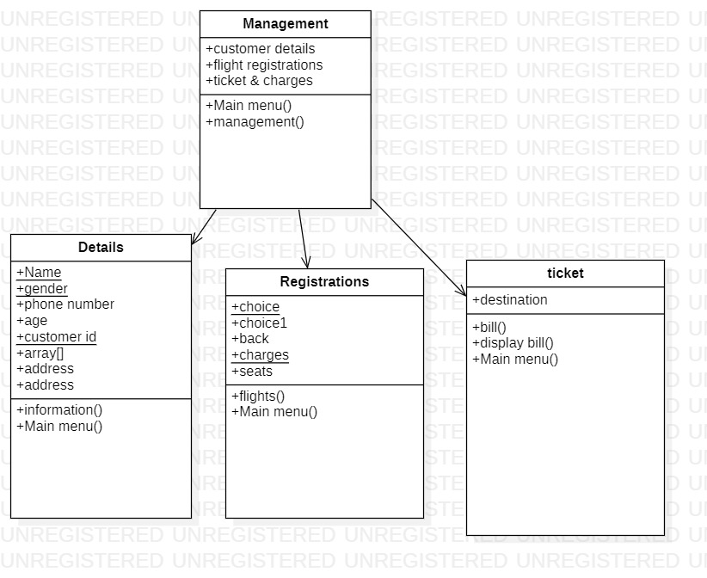
Class diagram:

Slide 6
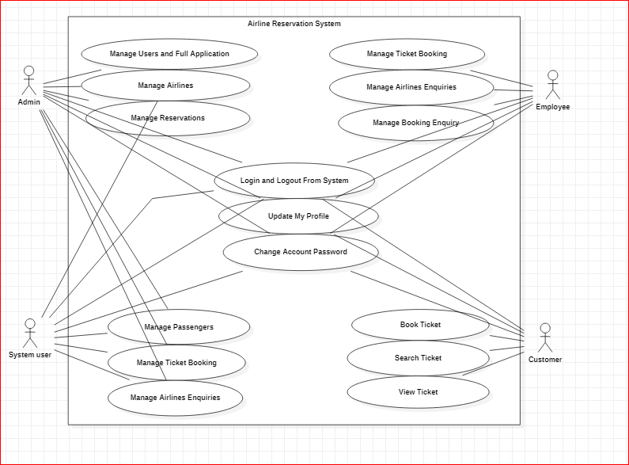
USE CASE DIAGRAM:

Slide 7
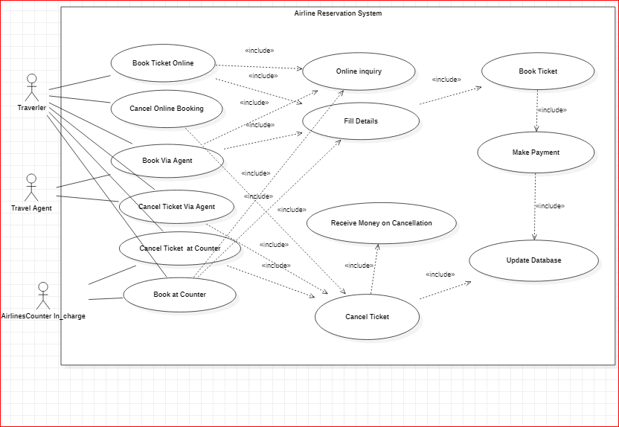

Slide 8
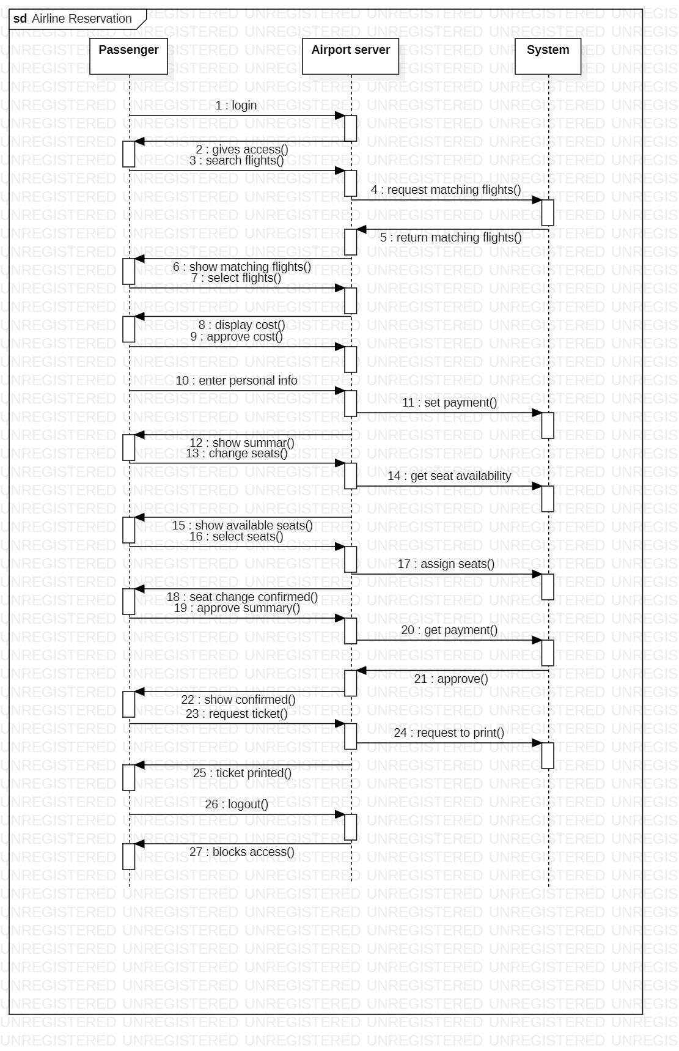
Sequence diagram

Slide 9
Classes:
Management class
Details class
Registration class
Ticket class

Slide 10
Details class:
In details class, the customers have to give the details such as ,
Name
Age
Customer Id
Gender
Address
Phone Number

Slide 11
Registration class:
In registration class, customers have to select the particular flights for registration. In this we mentioned,
Flight Id
Flight name
Date
Time
No of seats

Slide 12
Ticket class
In this ticket class, customers have to select the destination
List of customers
No of seats booked
Price
No of vacant seats

Slide 13
Advantages:
Easy to book tickets
Saves the time and money
Provides every information about flights
Send automated tickets to the customer by mail
Available for both domestic and international airline systems

Slide 14
Future scope:
Airline Reservation System is one the modifications that were carried out in the Passenger Service System so that the working and availability of Service area can be broadened . This is basically an interface of Global distribution System to carry out reservations on the desired airline from any place. Airline Reservation System make the life of passengers very easy as they don’t need to stand in queues for getting their seats reserved and they can easily make reservations on any airline just from a single system. On the other hand, it also removed an extra burden from the Airline Department as most of the passengers and travel agencies use this service instead of making reservations from the counters . With the help of this system, customers can view all the different flight’s availability with different timings for a particular date and it also allows them to reserve a seat, cancel a reservation or modify it.

Slide 15
conclusion
It reduces the scope of manual error and conveniently maintains any modifications, cancellations in the reservations. It not only provides flight details but also but also creates a platform to book tickets, cancels or modifies ticket timings or dates and even informs about the number of people on board!

Slide 16


